Slide 1



AcF 304 Financial Markets
Topic 6: The Money Markets
Part 2 – Money Markets Instruments
Notes:
If this PowerPoint presentation contains mathematical equations, you may need to check that your computer has the following installed:
1) MathType Plugin
2) Math Player (free versions available)
3) NVDA Reader (free versions available)

Slide 2
Money Market Instruments
We will examine each of these in the following slides:
Treasury Bills
Federal Funds
Repurchase Agreements
Negotiable Certificates of Deposit
Commercial Paper
Banker’s Acceptance
Eurodollars

Slide 3
Money Market Instruments: Treasury Bills
T-bills have 28-day maturities through 12-month maturities.
There are no interest payments on Treasury bills.
T-bills are issued at a discount from the value at maturity.
Discounting: When an investor pays less for the security than it will be worth when it matures, and the increase in price provides a return. This is common to short-term securities because they often mature before the issuer can mail out interest cheques.

Slide 4
Money Market Instruments: Treasury Bills Discounting Example
You pay $999.813 for a 28-day T-bill. It is worth $1,000 at maturity. What is its discount rate?
i_{discount} = (1,000 − 999.813) / 1,000 × 360/28
= 0.00240=.24%
i_{yt} = (1,000 − 999.813) / 999.813 × 365/28
= .00243 = .243%
Note:
1) The return is computed using the face amount in the denominator (return is underestimated)
2) A 360-day year is used. Return is also underestimated compared to a 365-day year

Slide 5
Money Market Instruments: Treasury Bill Auctions
T-bills are auctioned to the dealers each week.
The Treasury accepts competitive bids in ascending (descending) order of yields (prices) until the accepted bids reach the offering amount.
The Treasury may accept both competitive and noncompetitive bids, and the price everyone pays is the highest yield (lowest price) paid to any accepted bid.
Noncompetitive bids include only the amount
Competitive bids include the amount and the yield (price)

Slide 6
Money Market Instruments: Treasury Bill Auctions Example (1 of 2)
The US Treasury auctioned $2.6 billion par value 91-day T-bills, the following bids were received:
Bidder | Bid Amount | Bid Price
1 | $1 billion | $0.9960
2 | $750 million | $0.9921
3 | $1.5 billion | $0.9945
4 | $1 billion | $0.9956
5 | $600 million | $0.9959
If only these competitive bids are received, who will receive T-bills, in what quantity, and at what price?

Slide 7
Money Market Instruments: Treasury Bill Auctions Example (2 of 2)
Bidder | Bid Amount | Bid Price
1 | $ 1 billion | $0.9960
2 | $750 million | $0.9921
3 | $1.5 billion | $0.9945
4 | $1 billion | $0.9956
5 | $600 million | $0.9959
Bidder | Bid Amount | Bid Price
1 | $ 1 billion | $0.9960
5 | $600 million | $0.9959
4 | $ 1 billion | $0.9956
Solution: Bidders 1, 4, and 5 will receive T-bills in the amount requested all at $99.56.

Slide 8
Money Market Instruments: Treasury Bill Auctions Example (2 of 2)
For competitive and noncompetitive bidders ALL pay the highest yield / lowest price of any accepted bid i.e. 0.9956
Difference:
Competitive bidders may/may not be allocated T-Bills
Non-competitive – guaranteed allocation

Slide 9
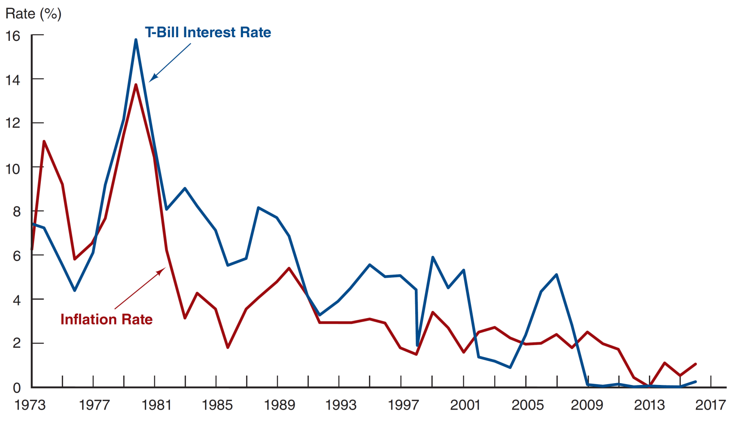
Figure 11.2 Treasury Bill Interest Rate and the Inflation Rate, January 1973–January 2016
Source: http://www.federalreserve.gov/releases and CPI: ftp://ftp.bls.gov/pub/special.requests/cpi/cpiai.txt.

Slide 10
Mini-Case: Treasury Bill Auctions Go Haywire
The Treasury auction of securities is supposed to be highly competitive and fair
In 1991, Salomon Smith Barney violated Treasury auction rules to corner the auction (94%) on an $11 billion issue.
purchased 35% of the Treasury securities
bought additional securities
charged a monopoly-like premium
Several top Salomon officials were forced to retire (or fired) as a result of the incident.
The Treasury also changed the auction rules to ensure a competitive auction.

Slide 11
Money Market Instruments: Federal Funds
Short-term funds transferred (loaned or borrowed) between financial institutions, usually for a period of one day.
Fed funds have nothing to do with the federal government
These funds are held at the Federal Reserve bank
Used by banks to meet short-term needs.
Meet reserve requirements: a certain percentage of their total deposits with the Federal Reserve.

Slide 12
Money Market Instruments: Fed Funds Rates
The next slide shows actual fed funds rates and T-bill rates 1990 through 2016.
The Federal Reserve cannot directly control fed fund rates.
The Fed indirectly influence by adjusting the amount of money in the financial system.
Notice that the two rates track fairly closely. What does this suggest about the market for T-bills and the market for fed funds?

Slide 13
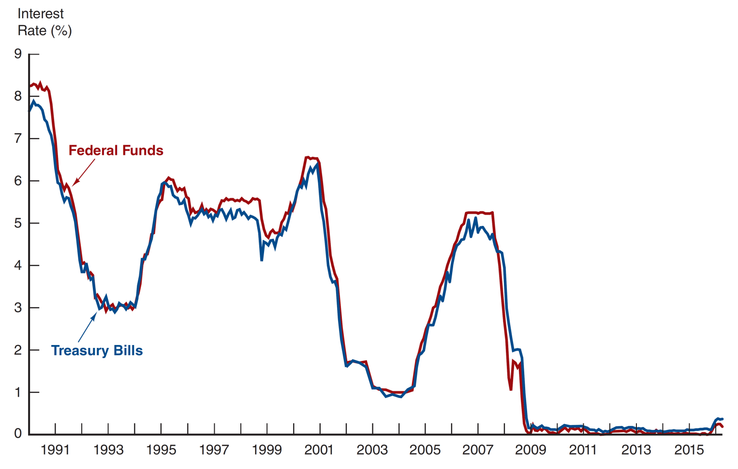
Figure 11.3 Federal Funds and Treasury Bill Interest Rates, January 1990–April 2016
Source: http://www.federalreserve.gov/releases/h15/data.htm.

Slide 14
Money Market Instruments: Repurchase Agreements
These work similar to the market for fed funds, but nonbanks can participate.
A firm sells Treasury securities but agrees to buy them back at a certain date (usually 3–14 days later) for a certain price.
This set-up makes a repo agreements essentially a short-term collateralized loan.
This is one market the Fed may use to conduct its monetary policy, whereby the Fed purchases/sells Treasury securities in the repo market.

Slide 15
Money Market Instruments: Negotiable Certificates of Deposit
A bank-issued security that documents a deposit and specifies the interest rate and the maturity date.
It is a term security due to a specified maturity.
It is also a bearer instrument: whoever holds the instrument at maturity receives the principal and interest.
Denominations range from $100,000 to $10 million.
Interest rates are negotiated between the bank and the customer and are similar to rates of other money market instruments.

Slide 16
Money Market Instruments: Commercial Paper (1 of 4)
Unsecured promissory notes, issued by corporations, that mature in no more than 270 days.
The use of commercial paper increased significantly in the early 1980s because of the rising cost of bank loans.

Slide 17
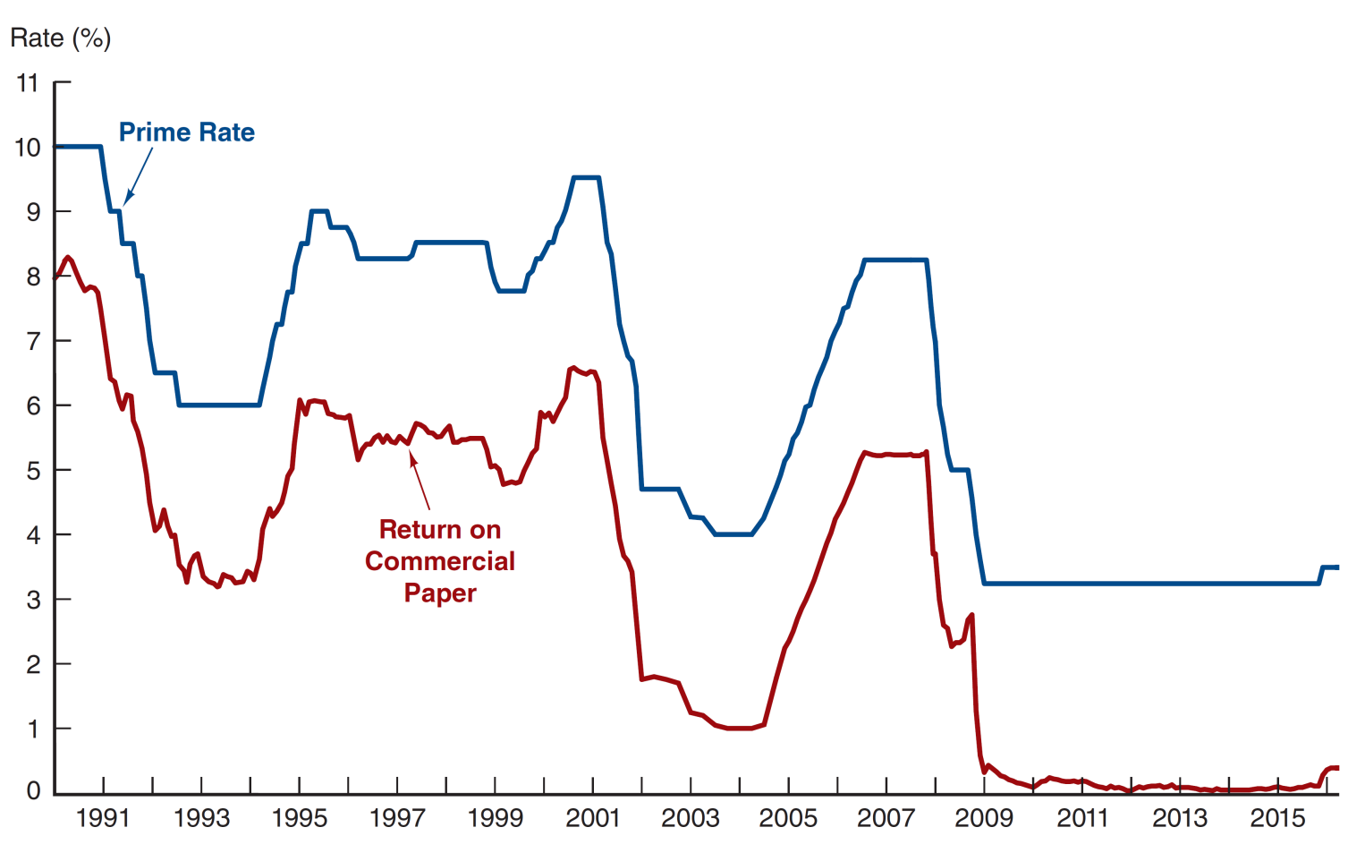
Figure 11.4 Return on Commercial Paper and the Prime Rate, 1990–April 2016
Source: http://www.federalreserve.gov/releases/h15/data/Monthly/H15_PRIME_NA.txt.

Slide 18
Money Market Instruments: Commercial Paper (2 of 4)
Commercial paper volume:
fell significantly during the 2008 and 2020 economic recession
annual market is still large, at well over $0.85 trillion outstanding

Slide 19
Money Market Instruments: Commercial Paper (3 of 4)
A special type of commercial paper, known as asset-backed commercial paper (ABCP)
played a key role in the financial crisis in 2008 backed by securitized mortgages
often difficult to understand
accounted for about $1 trillion

Slide 20
Money Market Instruments: Commercial Paper (4 of 4)
When the poor quality of the underlying assets was exposed, a run on ABCP began. Because ABCP was held by many money market mutual funds (MMMFs), these funds also experienced a run. The government eventually had to step in to prevent the collapse of the MMMF market.

Slide 21
Bankers Acceptances
An order to pay a specified amount of money to the bearer on a given date
Bank acts as a middleman between 2 corporate clients who might not know each other
The bank substitutes its creditworthiness for that of the buyer (who must pay) in a trade finance transaction.

Slide 22
Money Market Instruments: Eurodollars (1 of 2)
Eurodollars represent Dollar denominated deposits held in foreign banks.
The market is essential since many foreign contracts call for payment is U.S. dollars due to the stability of the dollar, relative to other currencies.

Slide 23
Money Market Instruments: Eurodollars (2 of 2)
The Eurodollar market has continued to grow rapidly because depositors receive a higher rate of return on a dollar deposit in the Eurodollar market than in the domestic market.
Multinational banks are not subject to the same regulations restricting U.S. banks and because they are willing to accept narrower spreads between the interest paid on deposits and the interest earned on loans.

Slide 24
Money Market Instruments: Eurodollars Rates
London interbank bid rate (LIBID)
The rate paid by a bank if another bank lends funds
London interbank offer rate (LIBOR)
The rate paid by a bank that borrows funds
Time deposits with fixed maturities
Largest short-term security in the world
e.g. 3-month Eurodollar deposits
LIBID 2.25% LIBOR 2.50%

Slide 25
Global: Birth of the Eurodollar
The Eurodollar market is one of the most important financial markets, but oddly enough, it was fathered by the Soviet Union.
In the 1950s, the USSR had accumulated large dollar deposits, but all were in US banks. They feared the US might freeze them, but still wanted dollars. The USSR transferred the dollars to European banks, creating the Eurodollar market.

Slide 26
Other Eurocurrencies
Although the Eurodollar market is the biggest due to the international popularity of the US Dollar for trade any currency held outside the domestic country becomes a Eurocurrency e.g. Japanese Yen held in NY or London becomes ‘Euroyen’.
Note: This terminology/product has nothing to do with the EUR currency of Europe.
Note: This concept is the same in the Eurobond market. e.g. USD Eurobonds are bonds that trade outside the US. e.g. GBP Eurobonds are bonds that trade outside the UK.

Slide 27
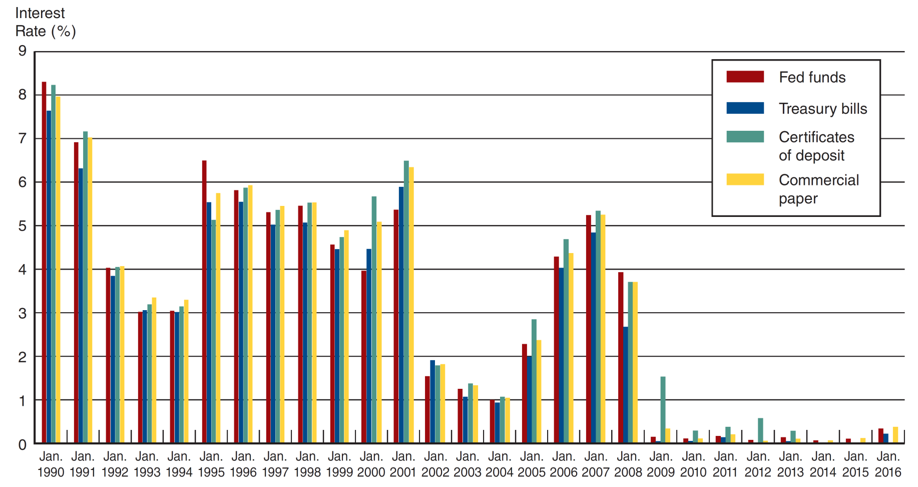
Figure 11.6 Interest Rates on Money Market Securities, 1990–2016
Source: http://www.federalreserve.gov/releases/h15/data.htm.

Slide 28
Comparing Money Market Securities
Liquidity is also an important feature, which is closely tied to the depth of the secondary market for the various instruments.

Slide 29
Table 11.4 Money Market Securities and Their Markets
Money Market Security | Issuer | Buyer | Usual Maturity | Secondary Market
Treasury bills | U.S. government | Consumers and companies | 4, 13, 26, and 52 weeks | Excellent
Federal funds | Banks | Banks | 1 to 7 days | None
Repurchase agreements | Businesses and banks | Businesses and banks | 1 to 15 days | Good
Negotiable CDs | Large money center banks | Businesses | 14 to 120 days | Good
Commercial paper | Finance companies and businesses | Businesses | 1 to 270 days | Poor
Banker’s acceptances | Banks | Businesses | 30 to 180 days | Good
Eurodollar deposits | Non-U.S. banks | Businesses, governments, and banks | 1 day to 1 year | Poor

Slide 30
Money Market Instruments
Interest Bearing Instruments | Discount Instruments | Derivatives
Interbank Deposits | Treasury Bill, T-Bill | Forward Rate Agreement, FRA
Certificates of Deposit (CD) | Commercial Paper, CP | Interest Rate Futures
Repurchase Agreement (REPO) |  | Overnight Index Swaps

Slide 31
AcF 304 Financial Markets
Topic 6: The Money Markets
Part 3 – Money Markets in Practise
Notes:
If this PowerPoint presentation contains mathematical equations, you may need to check that your computer has the following installed:
1) MathType Plugin
2) Math Player (free versions available)
3) NVDA Reader (free versions available)

